Slide 1
Commissioning and Operating a Direct Metal Laser Melting (DMLM) 3D Printer
Riley Shepard, Erik Leon, Sichao Jiang

Slide 2
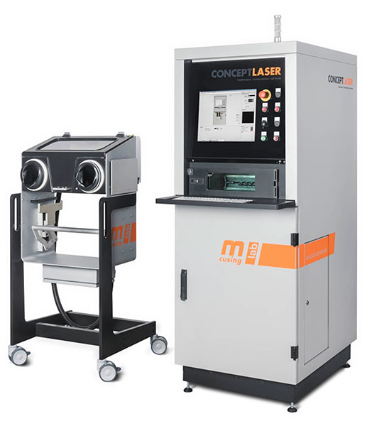
Project Description
Printer: Concept Laser MLab Cusing 100R
Final Commissioning
Individual Design Projects
Service- Please contact us if interested
Impact: Expand NAU's manufacturing capabilities
Mentors: Mike Downey, Justin Sokel
Client: IDEA Lab and ME Department- Dr. Ciocanel
Figure 1: Concept Laser MLab cusing 100 R
Sichao, 1

Slide 3
Black Box Model
Sinter Powder Together
Sintered Part Out
Metal Powder & Inert Gas in
Energy
Heat
Slicer Print Commands in
End Print Procedure
Figure 2: Black Box Model
Riley, 2

Slide 4
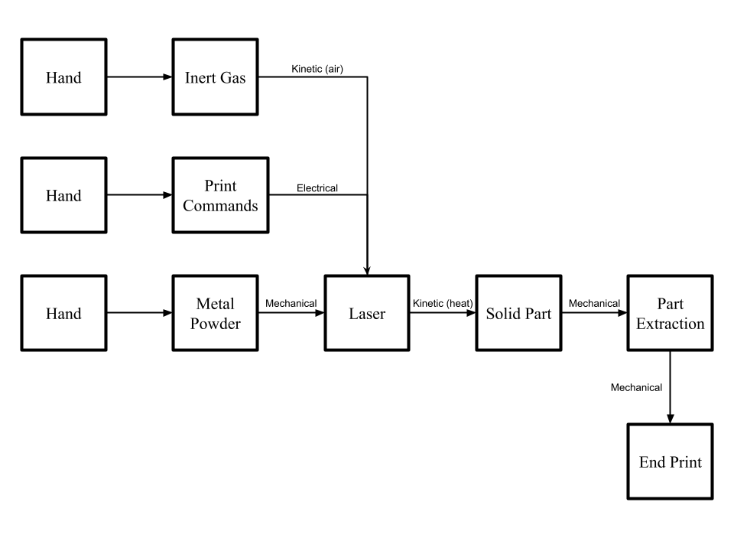
Functional Model
Figure 3: Printer Functional Model
Erik, 3

Slide 5
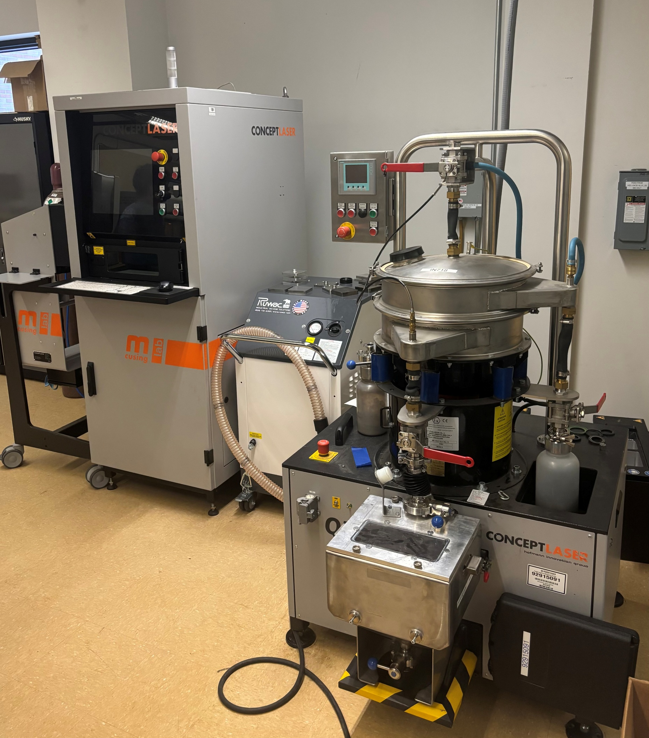
Commissioning Update
Complete:
Printer operational
Sieve operational
Wet separator operational
New Task:
Finalize Design/Order/Build safe room
80/20 for frame
Air Filter and Fan for Circulation
Negative pressure
Figure 4: Printer, Sieve, and Wet Separator
Sichao, 4

Slide 6
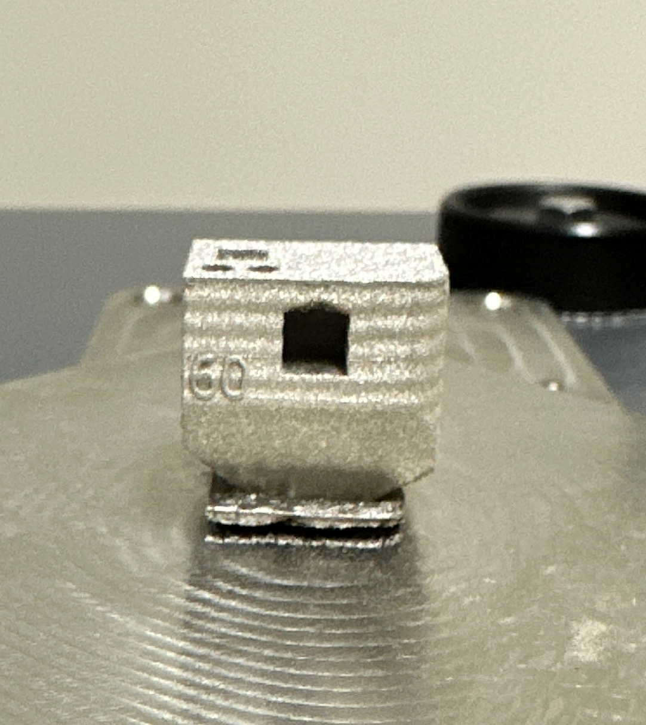
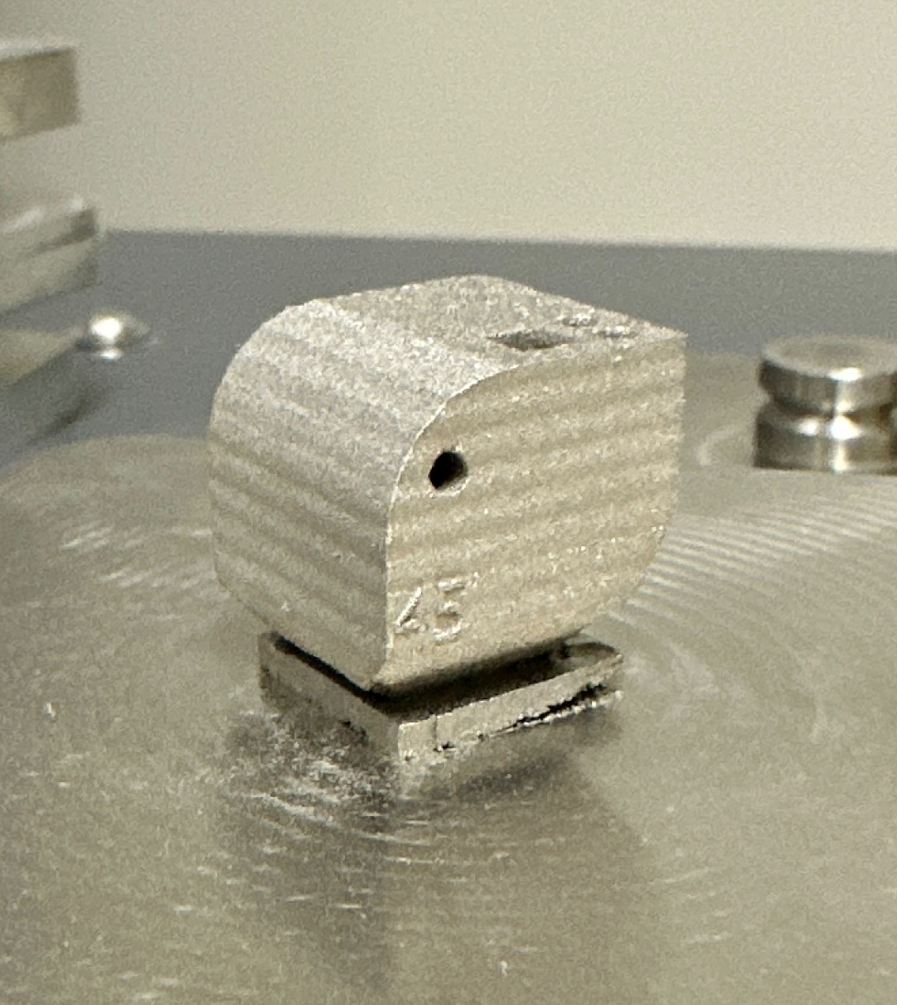
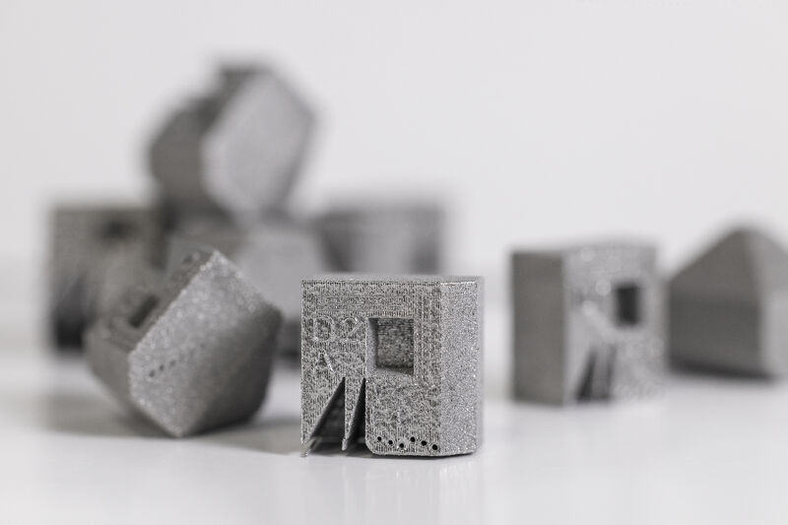
Commissioning Update
Printed First Diagnostic Part:
Based on Gao Block [1], [2]
Designed in SW
20x20x20mm Cube
Sliced with build plate
Figure 6: Team’s 1st Test Print
Figure 5: Gao Block [1]
Riley, 5

Slide 7
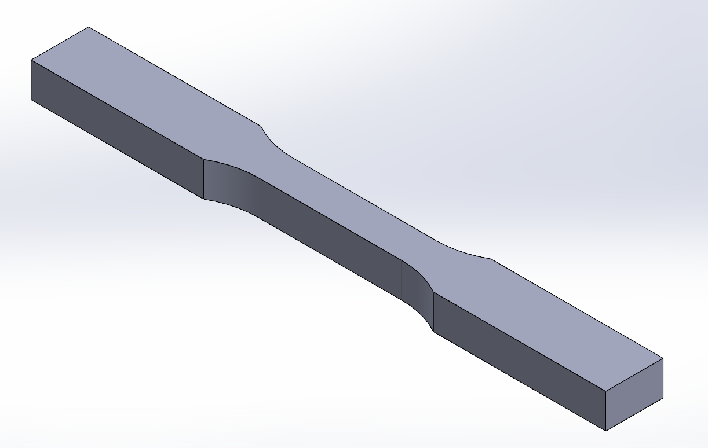
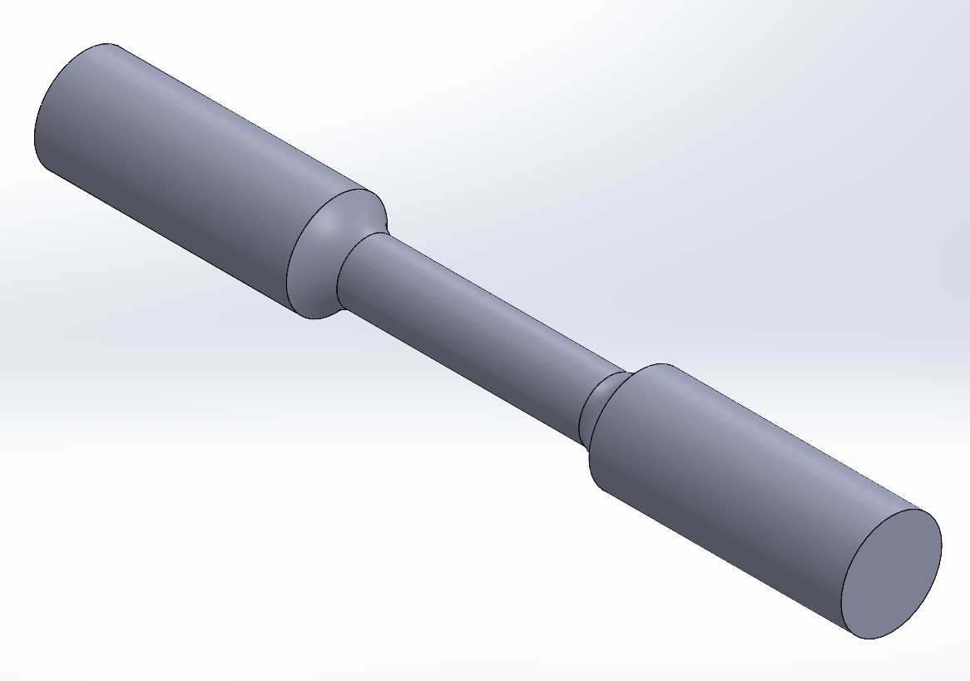
Commissioning Update
Initial part files for dog bone test specimens created:
Compliant with ASTM E8/E8M [3]
Flat
Gauge Length: 50mm
Round
Gauge Length: 24mm
Figure 7: Flat Test Specimen CAD Model
Figure 8: Round Test Specimen CAD Model
Sichao, 6

Slide 8
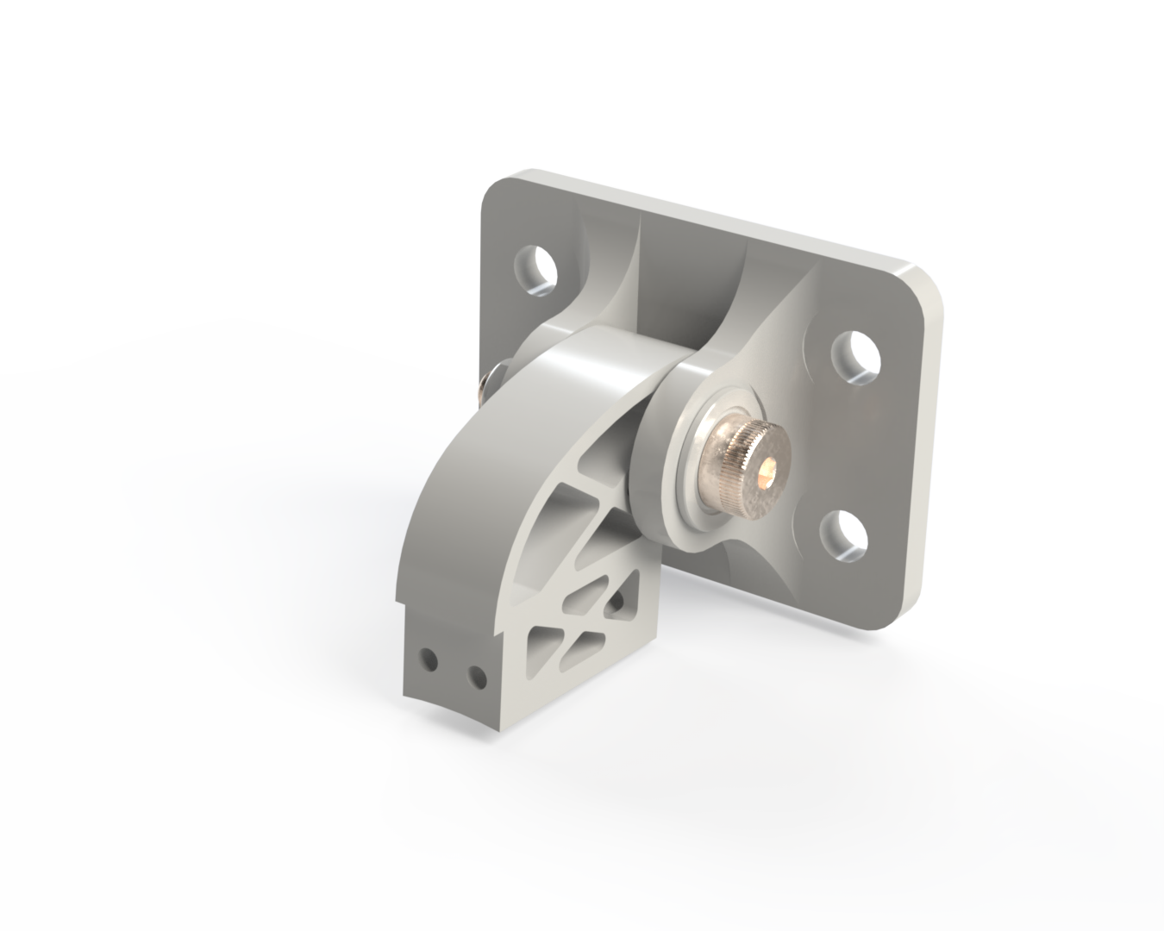
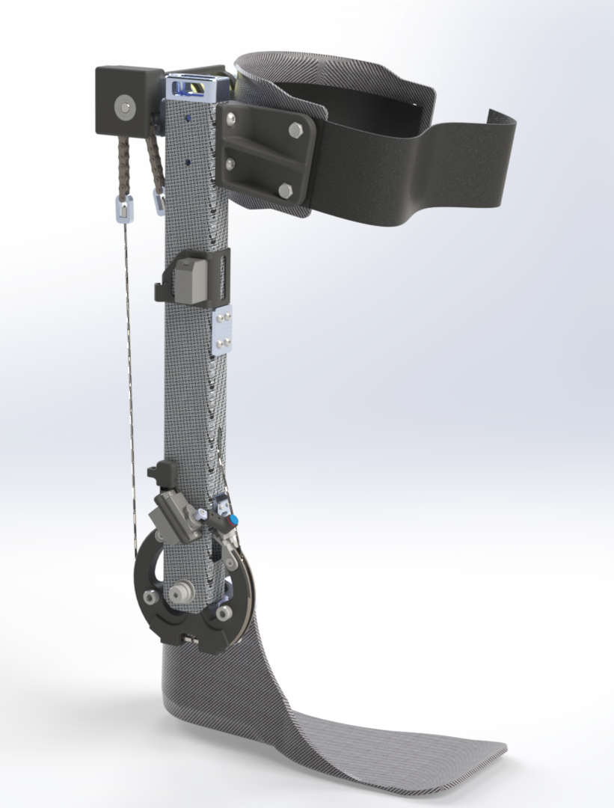
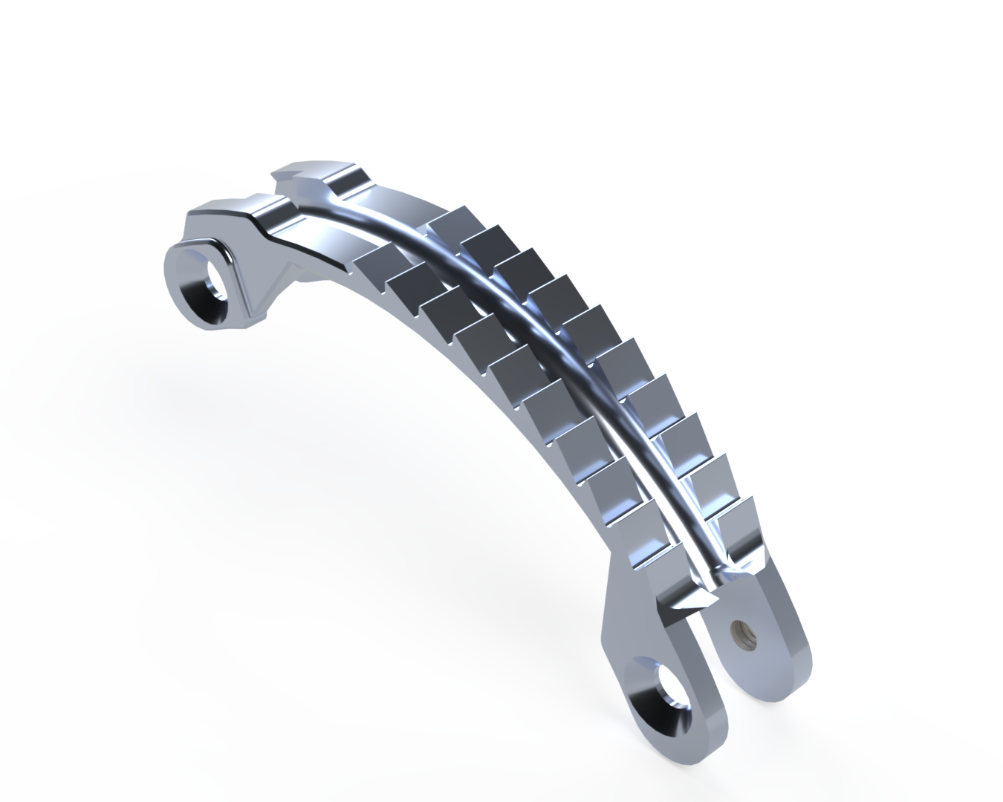
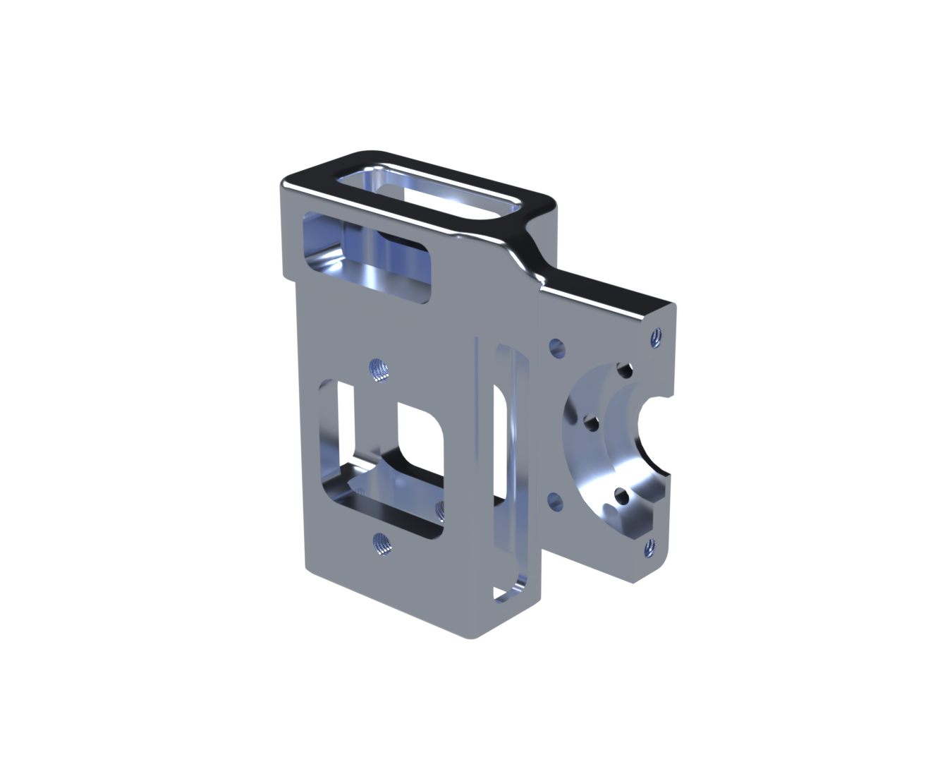
Concept Generation
Biomech Lab Machined Parts:
Hip Abduction Bracket
Toothed Pulley Bridge
Maxon Motor Mount
Figure 9: Individual Parts
Figure 10: Ankle Exo Design
Riley, 7

Slide 9
Concept Evaluation
Scoring Table
Criteria | Target | Hip Bracket | Toothed Bridge | Motor Mount
Topology Optimization Potential | High | High | Low | Moderate-Low
Post- Processing Requirements | Low | Low | Moderate | High
Fits within print volume | Yes | Yes | Yes | Yes
Visualization in Assembly | High | High | Moderate-Low | Low
Riley, 8

Slide 10
Concept Selection
Final Selection:
Hip Abduction Bracket
Riley, 9

Slide 11
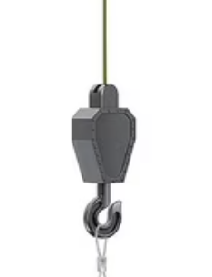
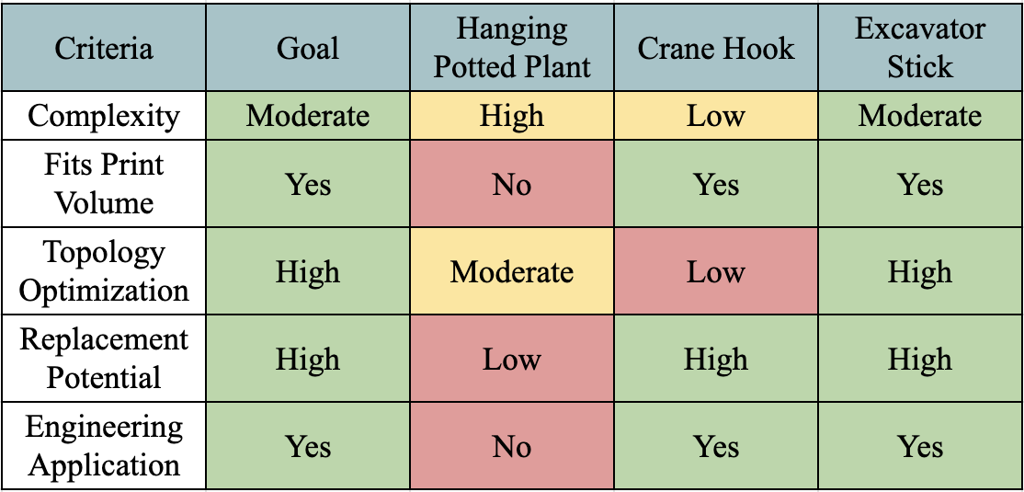
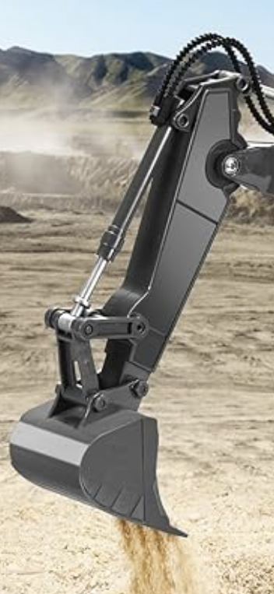
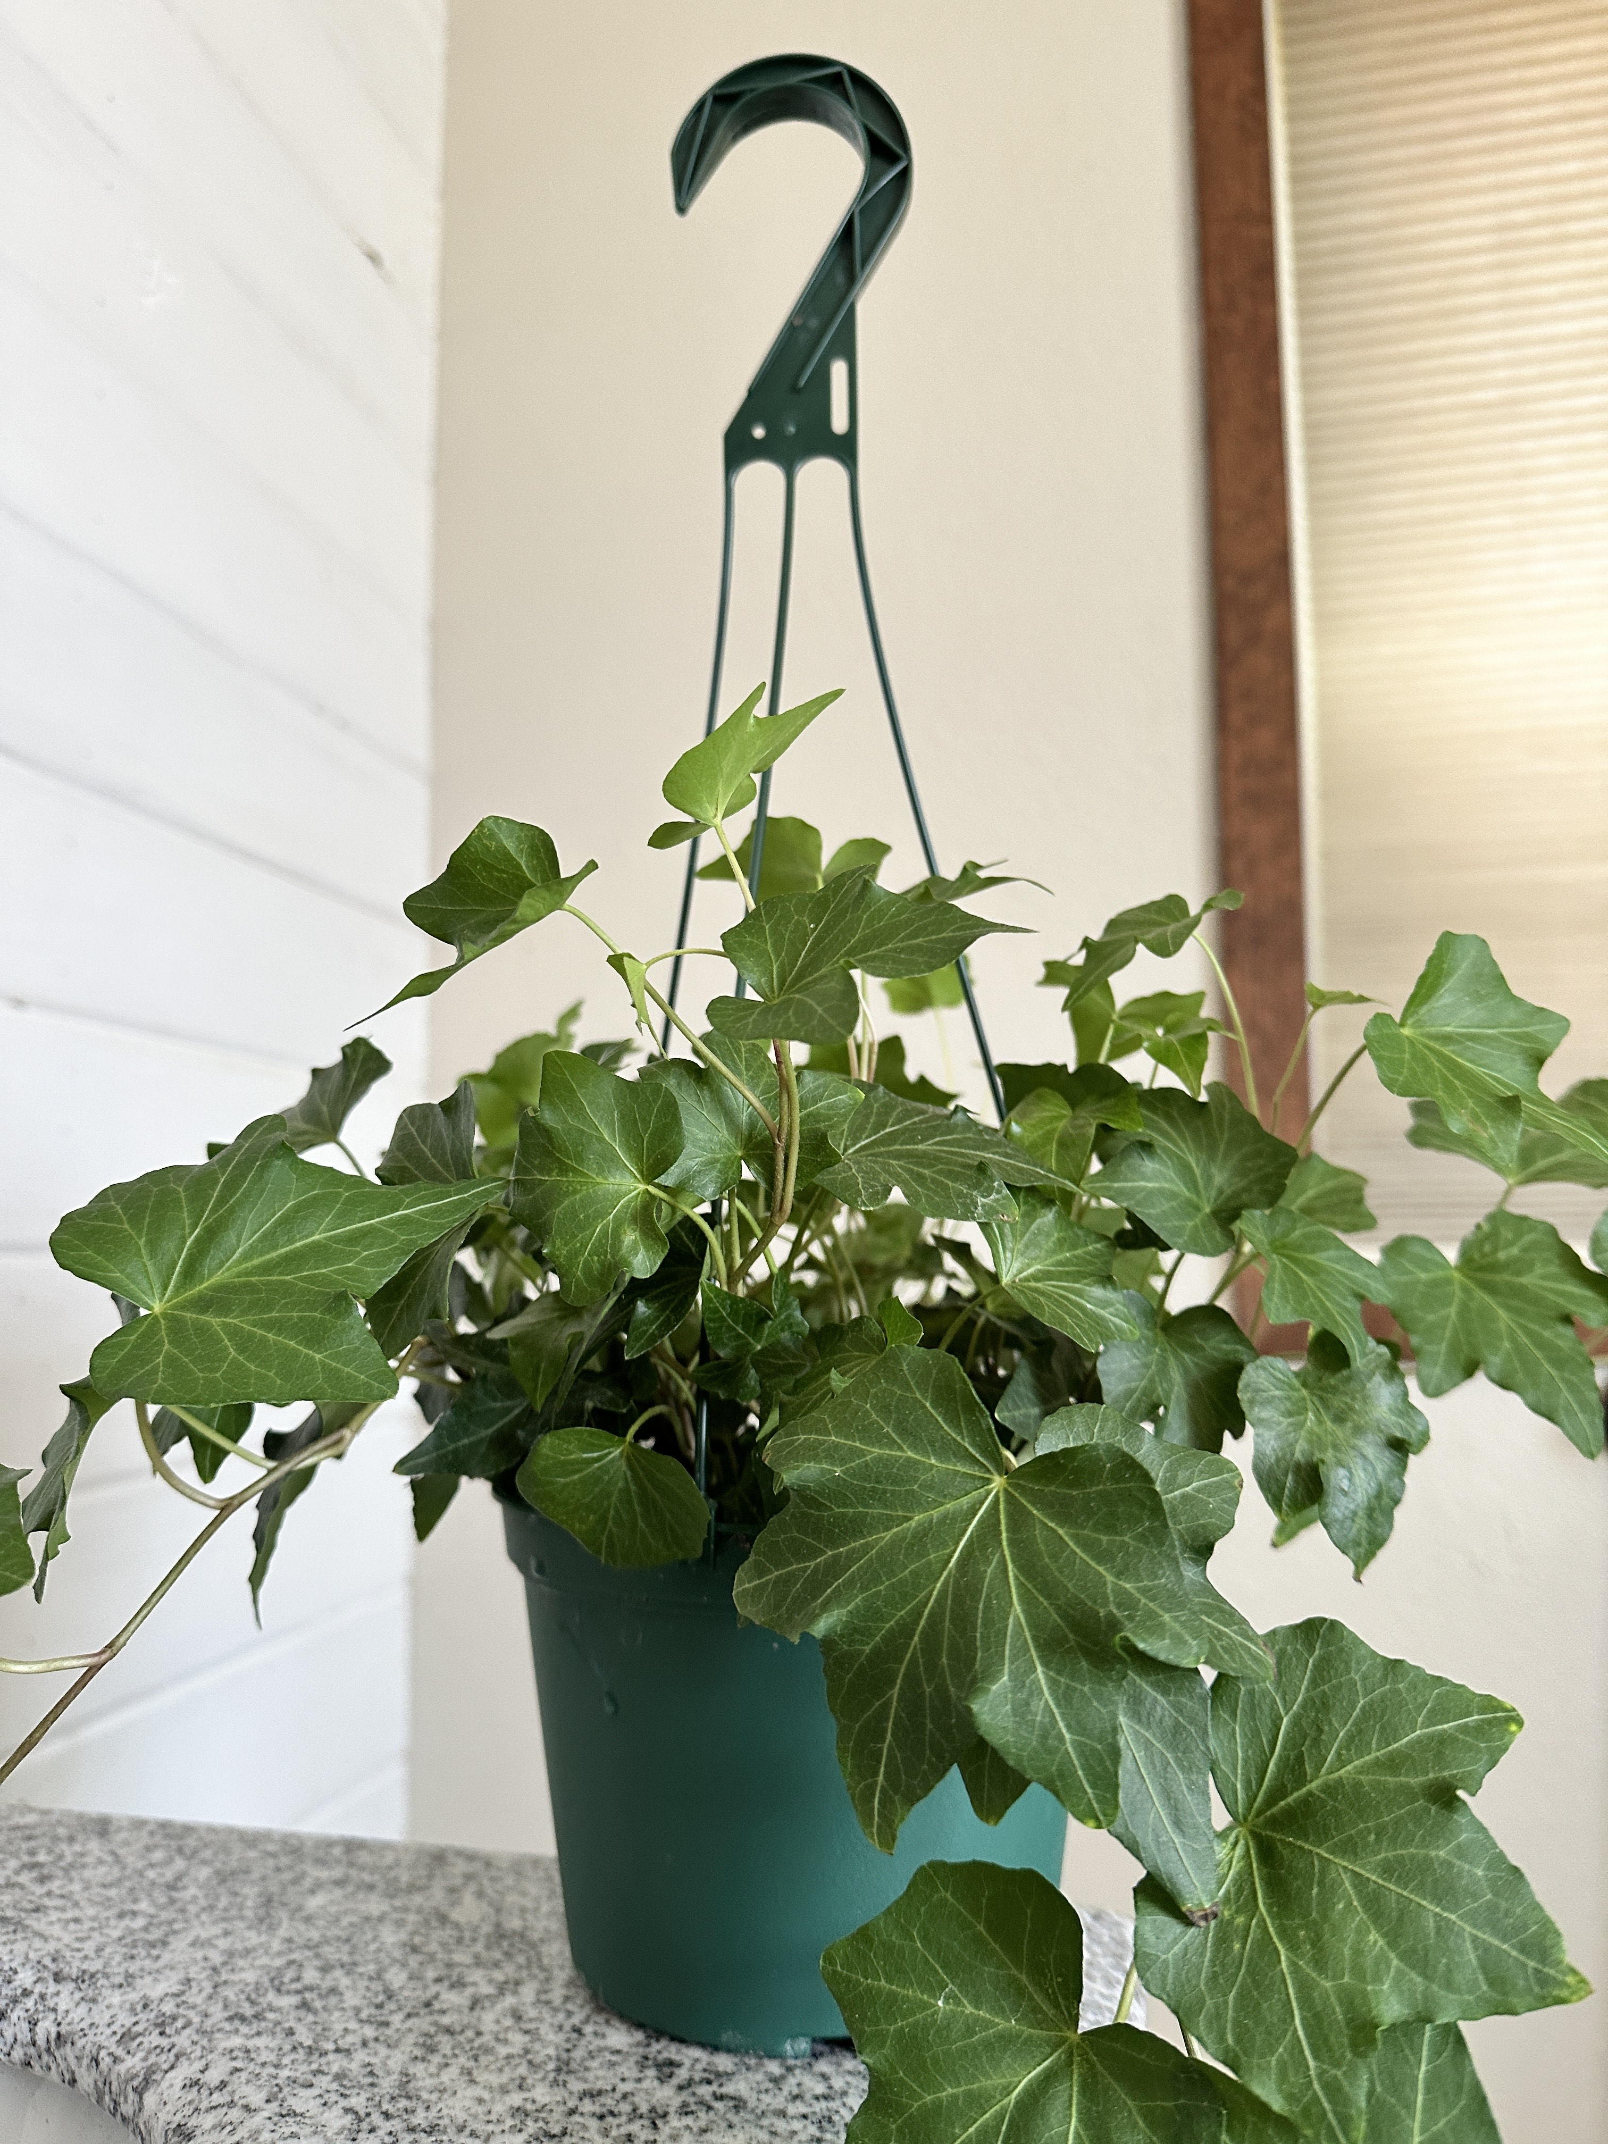
Concept Generation, Evaluation, and Selection
Figure 14: Crane Hook
Figure 16: Excavator Stick
Figure 15: Hanging Pot
Erik, 11

Slide 12
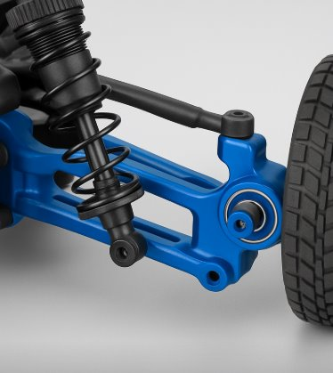
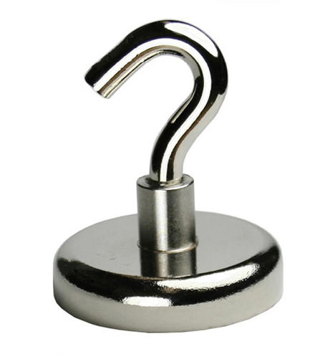
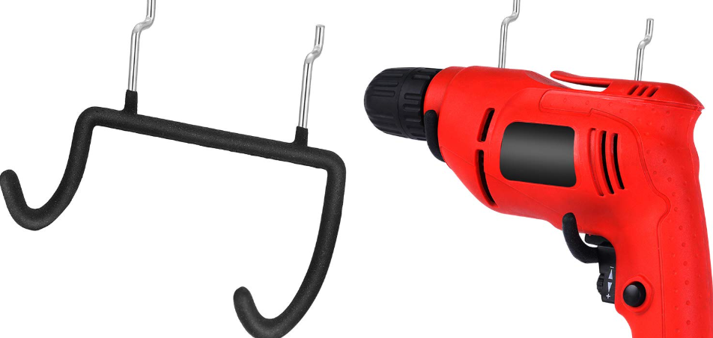
Concept Generation, Evaluation, and Selection
Criteria | Basic magnetic hook | Pegboard power drill holder | RC car steering knuckle
Functional Complexity | Low | Moderate | High
Fit & Integration with Assembly | Moderate | High | High
Topology Optimization | Low | Moderate | High
Figure 11: Magnetic Hook
Figure 12: Steering Knuckle
Figure 13: Power drill holder
Sichao, 10

Slide 13
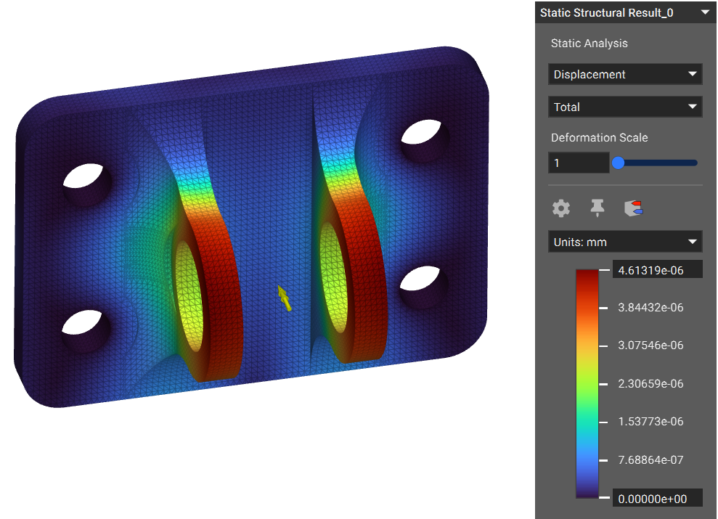
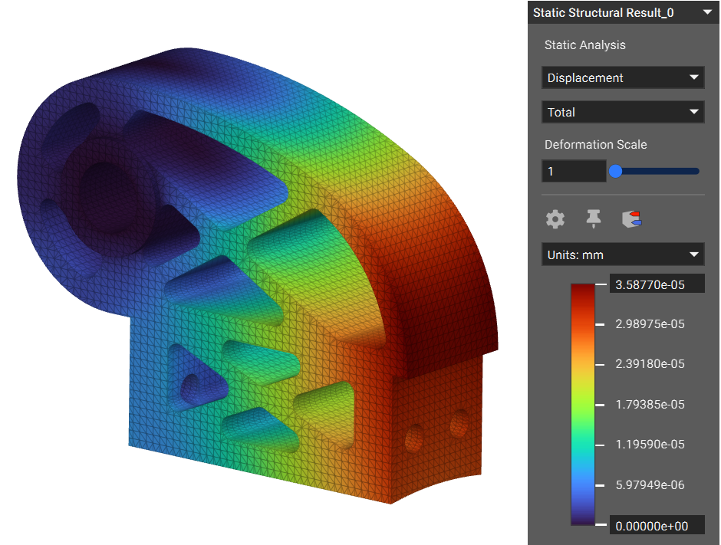
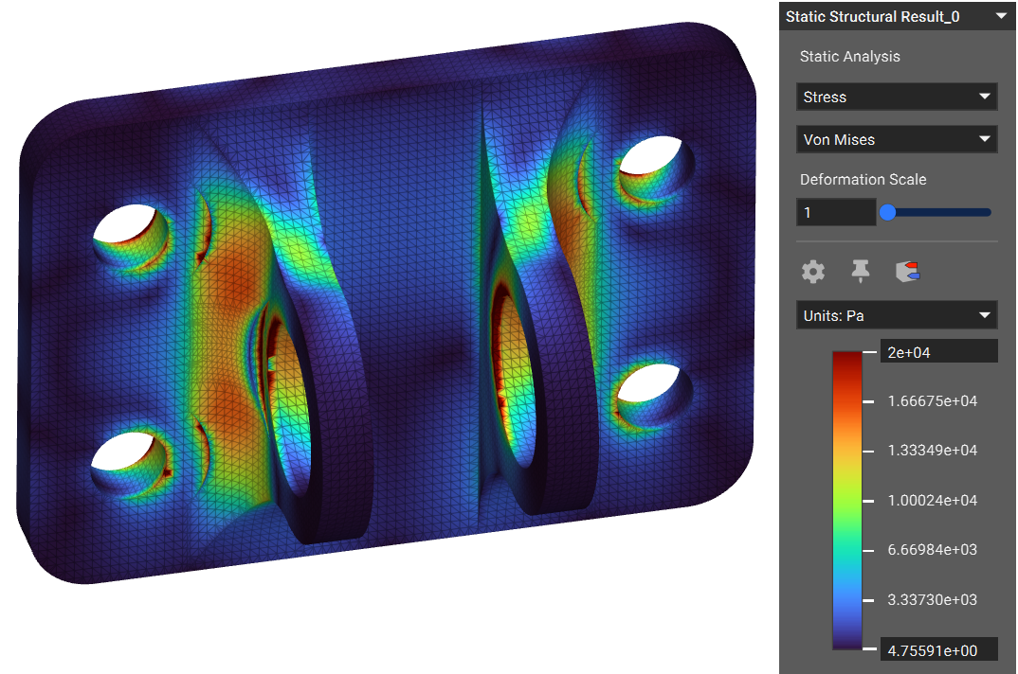
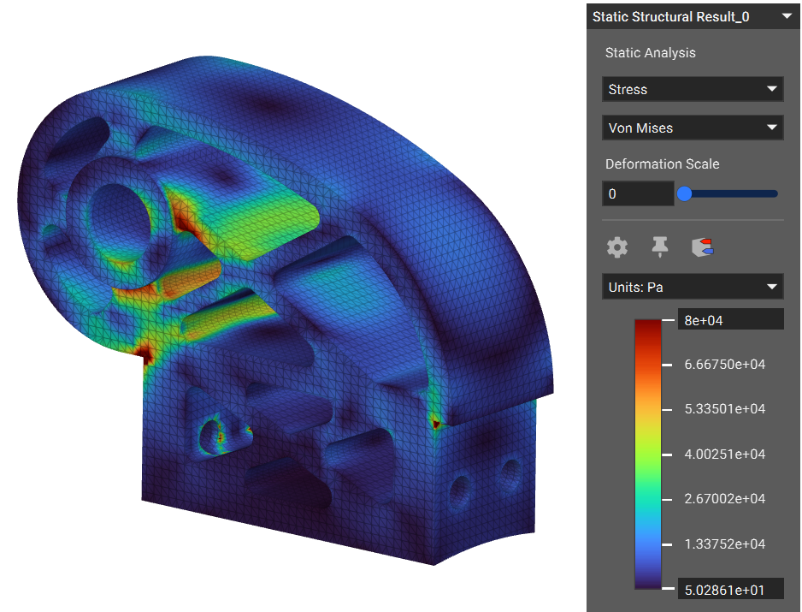
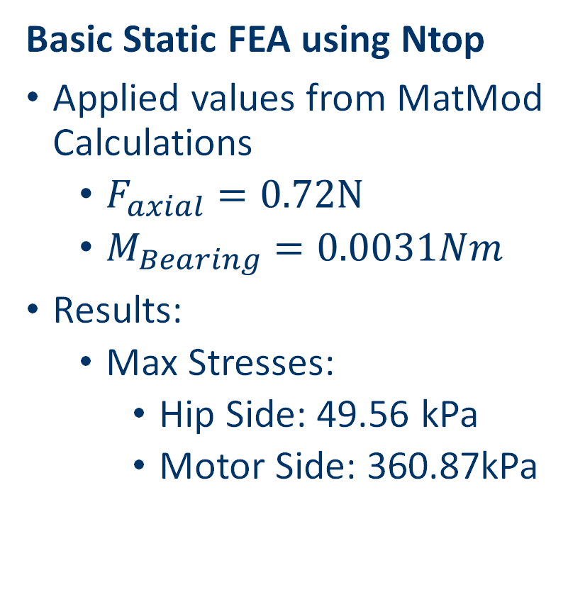
Hip Bracket Engineering Calculations
Basic Static FEA using Ntop
Applied values from MatMod Calculations
$F_{axial}=0.72N$
$M_{Bearing}=0.0031Nm$
Results:
Max Stresses:
Hip Side: 49.56 kPa
Motor Side: 360.87kPa
Figure 17: Hip Bracket FEA Results
Riley, 12

Slide 14
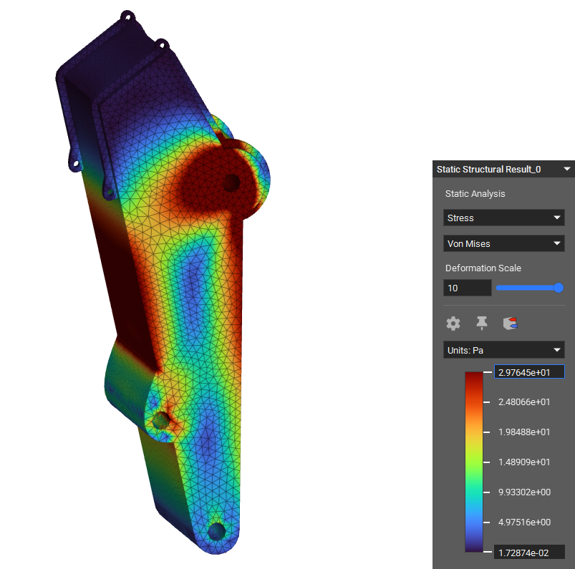
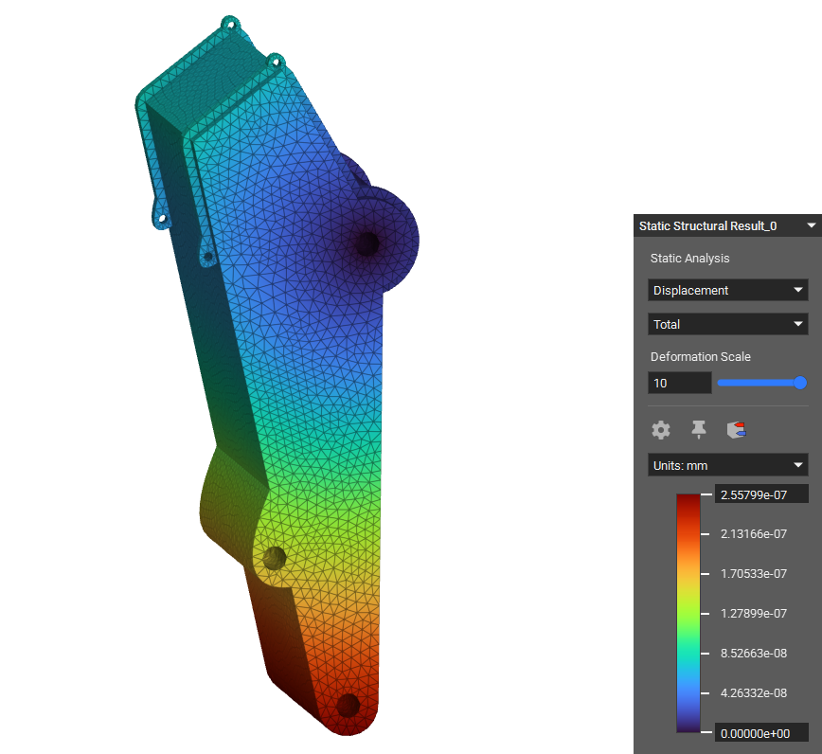
RC Excavator Stick Engineering Calculations
Basic Static Finite Element Analysis
Applied Values:
Moment @ Bucket = .02Nm
Axial Force @ Bucket = .00091N
Results:
Max stress ~3Pa
Figure 18: Excavator Stick FEA Results
Erik, 13

Slide 15
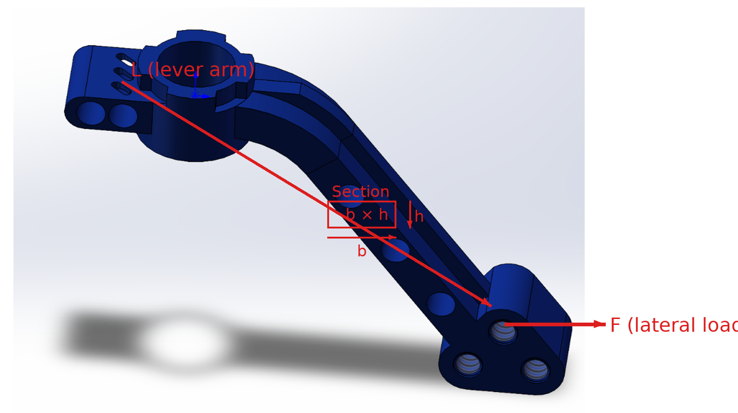
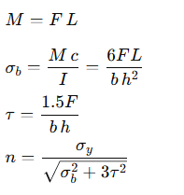

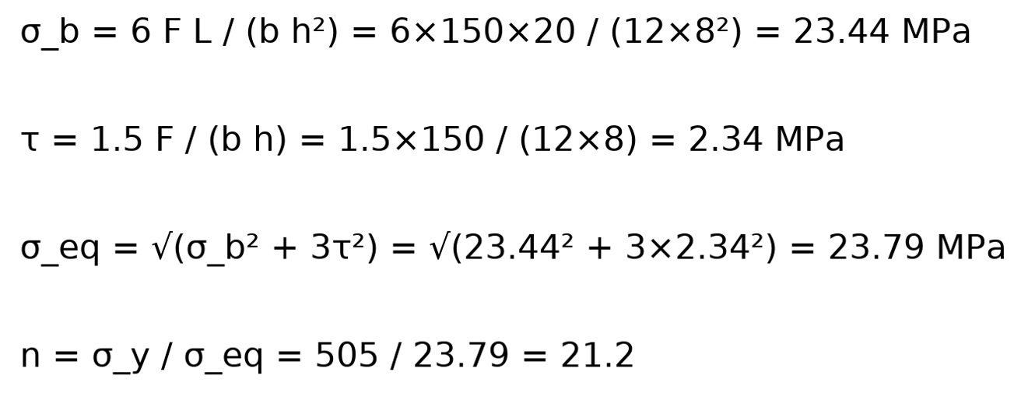
RC Steering Knuckle Engineering Calculations
Equations：
Bending Moment Equation
Bending Stress Equation
Shear Stress Equation
Static Safety Factor
Results：
Figure 19: Steering Bracket XXX
Sichao, 14

Slide 16
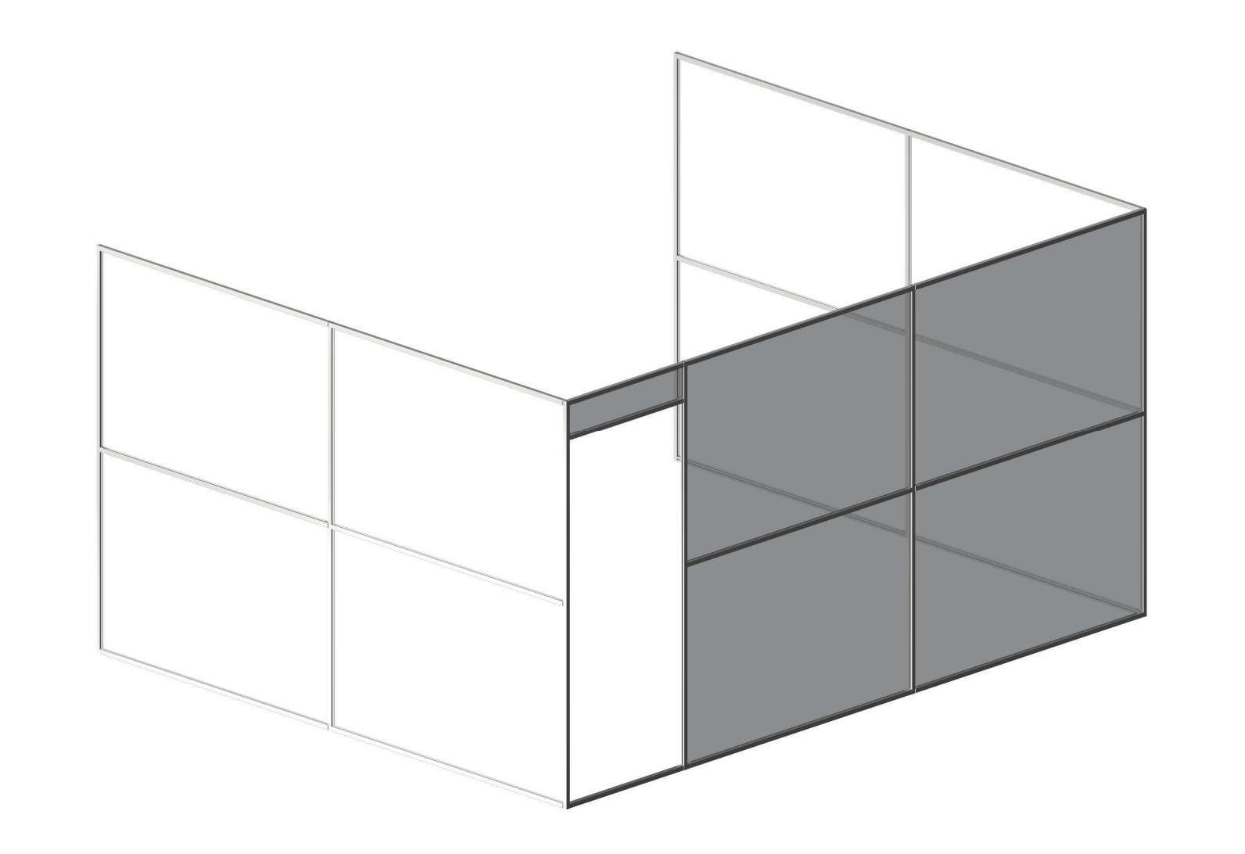
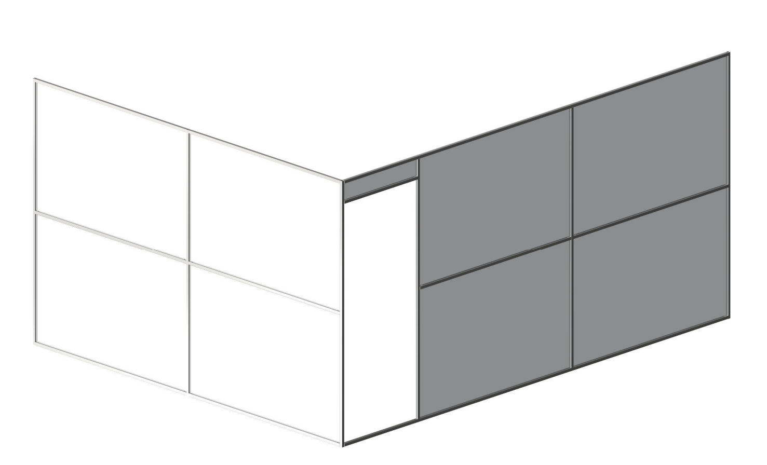
Partition Generation
80/20 IdeaBuilder
1x1" Aluminum T-slot
3/16" Clear Acrylic (2602)
Variations:
2-Wall vs. 3-Wall
86" vs 92" Height
Figure 20: 2-Wall, 86" Partition
Figure 21: 3-Wall, 86" Partition
Erik, 15

Slide 17
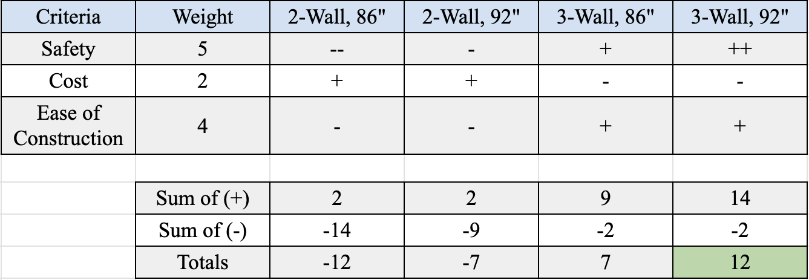
Partition Evaluation
Erik, 16

Slide 18
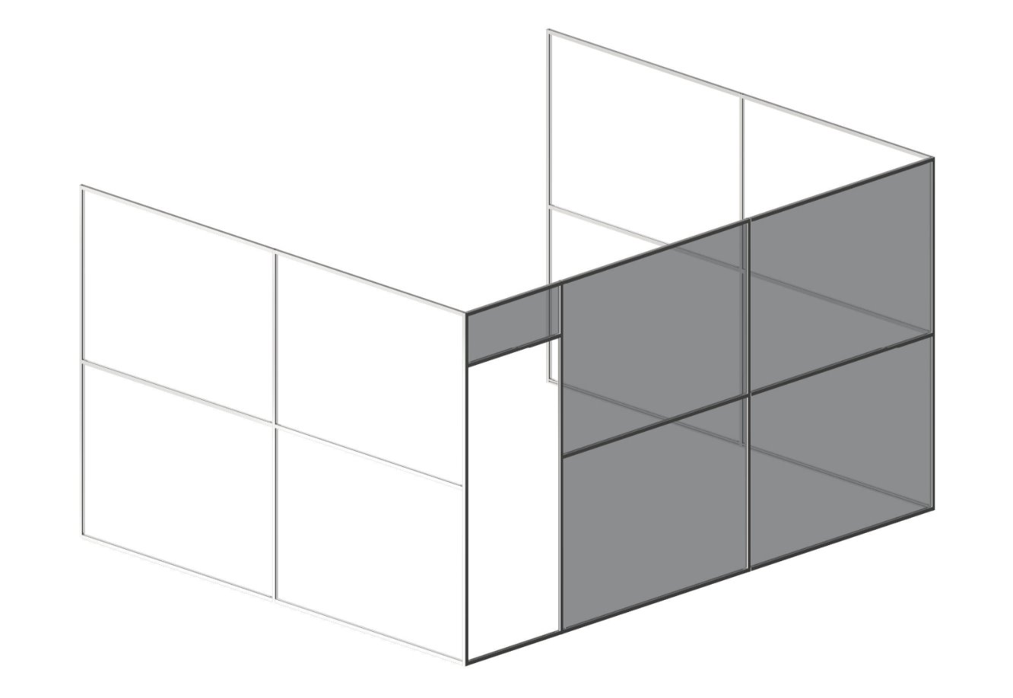
Partition Selection
Total Cost: $3600.02
Dimensions: 130x160x92"
Roof/Door: TBD
Figure 22: 3-Wall, 92" Partition
Erik, 17

Slide 19
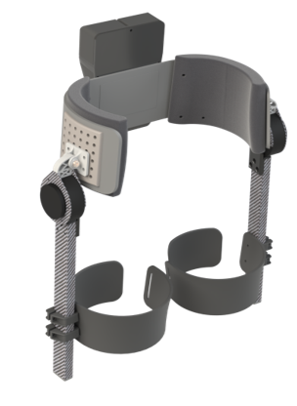
Rough CAD
Selected hip abduction bracket
Potential for outreach
Demos of hip device at schools (CHS) or for events
Showcase NAU’s AM capabilities
Clear visualization of component in assembly
Utilize unique geometries
Figure 23: Complete Hip Exo Assembly
Riley, 18

Slide 20
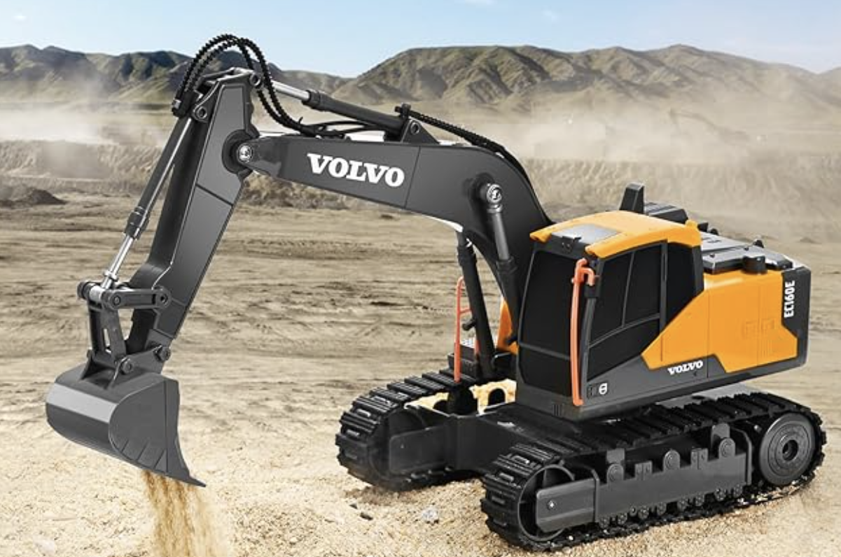

Rough CAD
Selected RC Excavator Stick
Potential for outreach
Showcase part replacement at school events
Clear visibility in the assembly
Figure 24: RC Excavator Full
Erik, 19

Slide 21
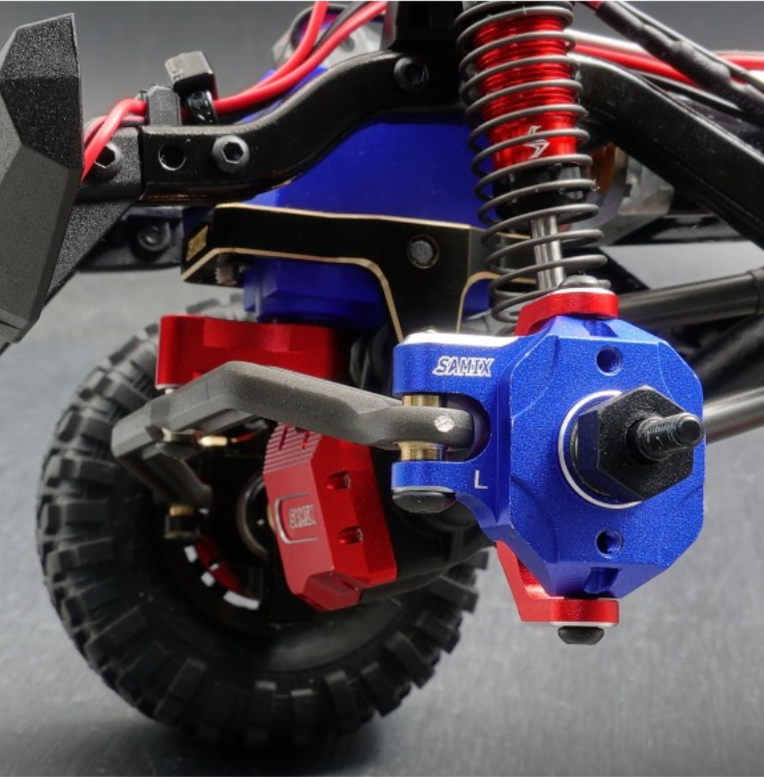
Rough CAD
Selected RC car steering knuckle
Integrate component into full assembly Add views of parts and interactions in CAD
Recruiting & Outreach Opportunities Showcase project at NAU events or community demonstrations
Figure 25: RC Steering Knuckle Close-up
Sichao, 20

Slide 22
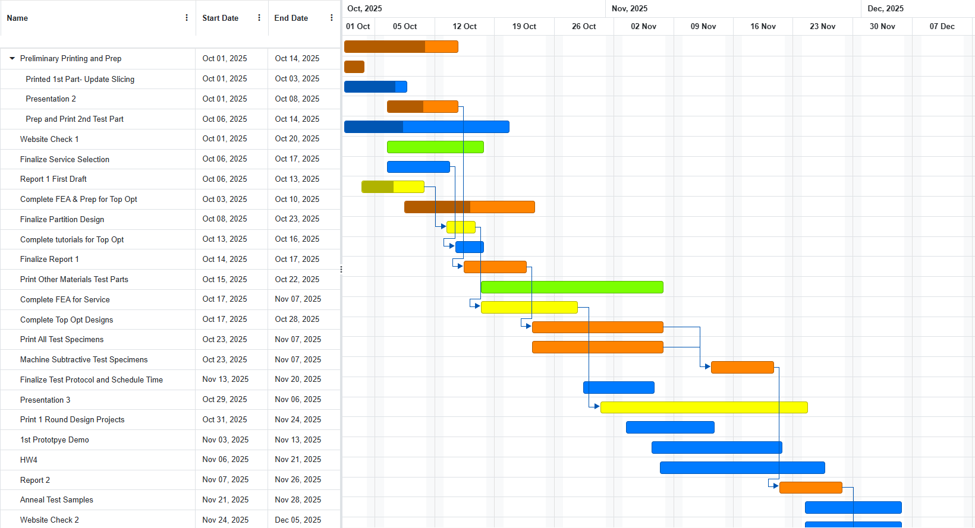
Schedule- GANT Chart
Riley, 21

Slide 23
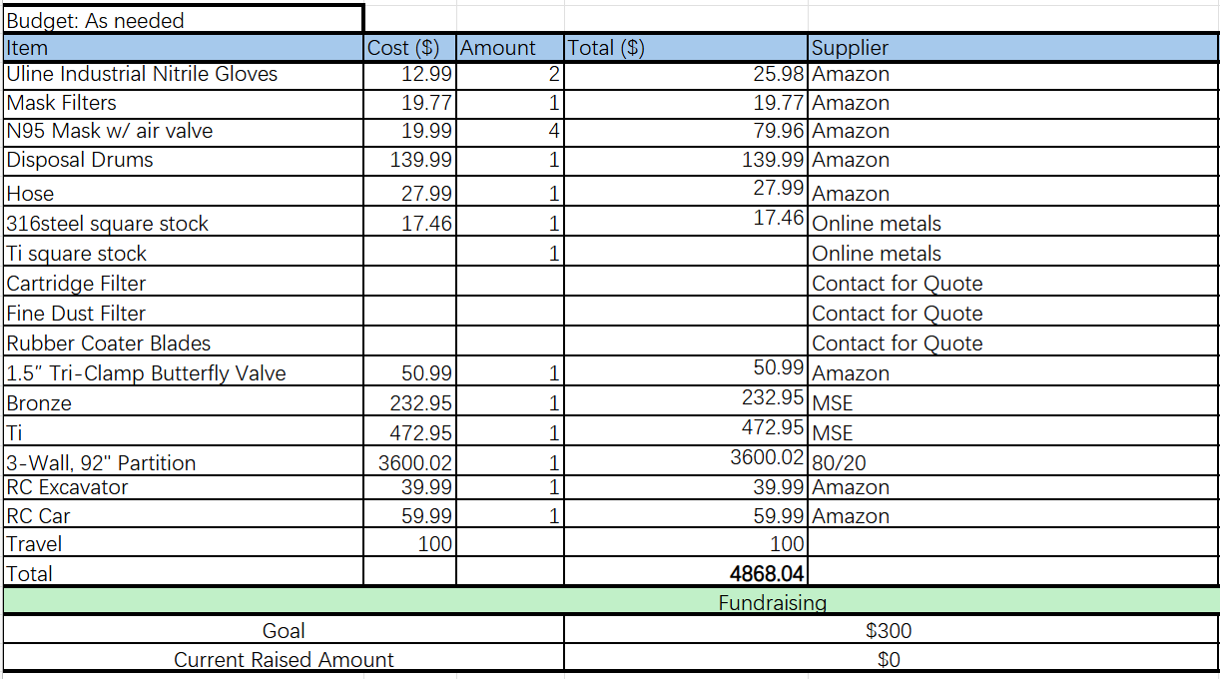
Budget and BOM
Table 5: Materials Order List
Sichao, 22

Slide 24
References
“Metallurgy & Process Development – Castheon,” Castheon.com, 2025. https://www.castheon.com/process-material/metallurgy-and-print-parameter-development/ (accessed Oct. 08, 2025).
L. Wilson, “ADDITIVE MANUFACTURING OF OXIDE DISPERSION STRENGTHENED MULTI PRINCIPLE ELEMENT ALLOYS FOR FUTURE AEROSPACE APPLICATIONS,” 2023. Accessed: Oct. 08, 2025. [Online]. Available: https://ntrs.nasa.gov/api/citations/20230005235/downloads/Dissertation_LWilson_2023.pdf?
“Test Methods for Tension Testing of Metallic Materials,” doi: https://doi.org/10.1520/e0008_e0008m-13a.

Slide 25
Thank you And Any Questions?

